Slide 1


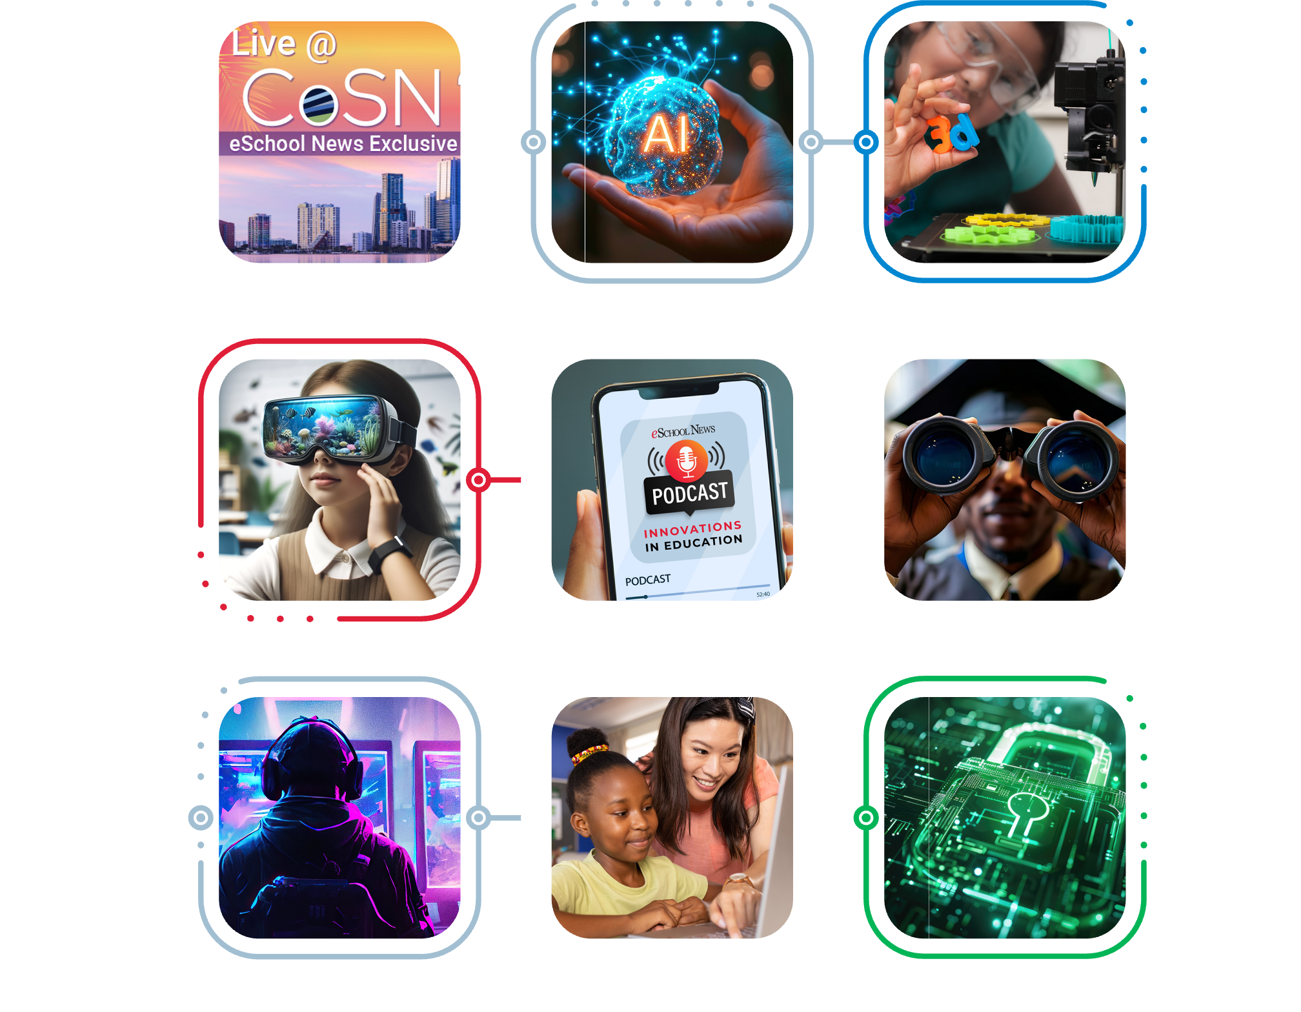
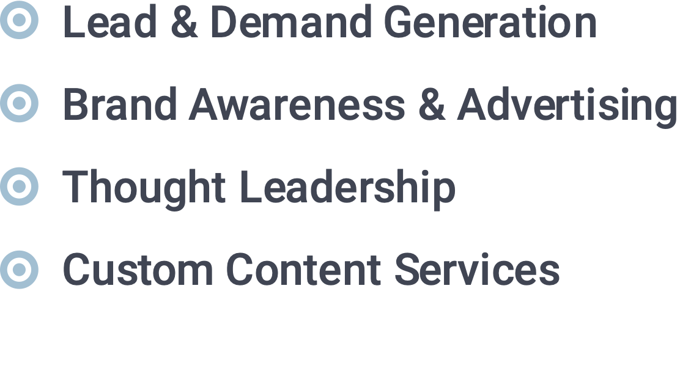
Digital Marketing
That Delivers
For companies serving the K-12 and Higher Education Markets
Jane Radenhausen J Daly Associates
407.898.2876 jane@jdalyassociates.com

Slide 2
Partnering with eSchool Media will amplify your brand and expand your audience of key education buyers who actively seek your solutions.

Slide 3
Company XYZ
PRODUCT LINE
Strategic Campaign • January 22, 2024

Slide 4
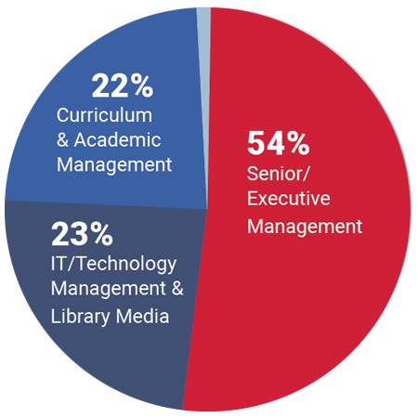
eSchool News Audience Profile
450,000+
Total Reach*
54% Senior/Executive Management
Titles Include: Superintendent, Assistant Superintendent, Deputy Superintendent, Associate Superintendent,
Regional Superintendent, Education Service Agency Director, Education Department Official, Principal,
Assistant Principal, Federal/State Program Director, State School Officer, Federal Official, District Administrator, Safety/Security Director, School Board Member, Governor’s Office Staff, Legislative Staff Member,
School Business Official/Purchasing, Facilities Management, College/University Official and More.
23% IT/Technology Management & Library Media
Titles Include: CIO/CTO, IT Director, Instructional Technology Director, MIS Director, Network Administrator, Library Services Director, Librarian/Media Specialist, Technology Coordinator, Technology Director and More.
22% Curriculum & Academic Management
Titles Include: Curriculum Director, Subject Area Supervisors & Instructors for Mathematics, Reading, Science, English/Language Arts, Social Studies, Languages, Trades, Business, Special Education Director, Directors/Coordinators of Gifted, Special Education, Vocational Education, Professional Development,
Director of Guidance and More.
*Google Analytics September 2024
1% Consultants, Vendors & Others Allied to the Edtech Industry

Slide 5
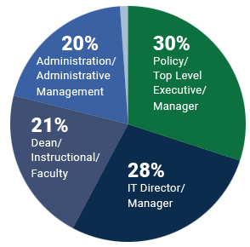
eCampus News Audience Profile
200,000+
Total Reach*
30% Policy/Top Level Executive/Manager
Titles Include: Academic Officer, Chancellor/President/CEO/Provost, Chief Development & Planning,
Director Branch Campus, Vice President, Policy/Top Level Executives & Managers, Federal & State Official, State School Official
28% IT Director/Manager
Titles Include: CIO, CTO, Library/Media Director/Manager, MIS & IT Director/Manager
21% Dean/Instructional/Faculty
Titles Include: Dean, Administrative Dean, Faculty Department Chair, Instructional & Curriculum Director
20% Administration/Administrative Management
Titles Include: Administration & Operations, Admissions & Registrar, Business Administrator, Financial & Funding Director/Manager, Safety & Security Director
1% Other Job Titles not listed above
*Google Analytics September 2024
Titles Include: Non-Educator, Parent, Vendor, College/University Student, Other

Slide 6
LEAD AND DEMAND GENERATION
We generate high quality leads to fuel your education sales.

Slide 7

LEAD AND DEMAND GENERATION
Content Syndication
Generate qualified sales leads by leveraging your organization’s content.
Leverage your company’s white papers, case studies, infographics or other content for maximum impact while generating qualified leads. Your assets will be hosted within our Resource Library where elite buyers and top education technology decision-makers will have access to your exclusive content 24/7. In addition, your asset(s) will be promoted through dedicated eMails to a targeted, engaged audience, generating the leads your sales team want.

Slide 8
LEAD AND DEMAND GENERATION
Content Syndication
What You Get:
A dedicated eSchool Media project manager to handle logistical support, including asset posting, landing page approval, and follow up.
An integrated marketing campaign to drive decision-makers to view your content.
Placement of your asset on our website(s)for instant download.
Weekly lead reporting, including all relevant data.
Leads counts and prices vary by program and are guaranteed.

Slide 9
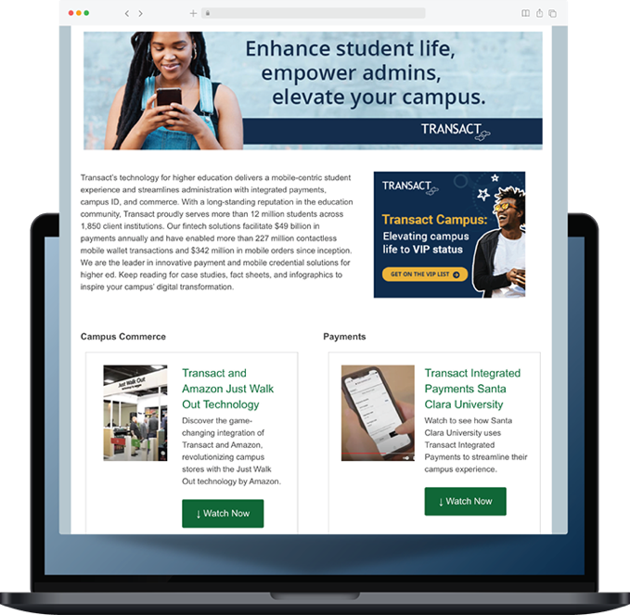
LEAD & DEMAND GENERATION
Education Resource Centers
Generate qualified sales leads with your own custom microsite featuring your content and solutions.
Highlighting your products and services in a custom ERC microsite puts your solutions right at the fingertips of education decision-makers. Your microsite will feature up to 8 downloaded pieces of your content, which we’ll promote to generate highly qualified leads interested in your solutions. Your ERC will stay live on our site for 90 days.

Slide 10
LEAD AND DEMAND GENERATION
Education Resource Centers
What You Get:
A dedicated eSchool Media project manager.
Full set-up and design of your ERC microsite, launch meetings and follow-up.
Your ERC will be posted for 90 days within the ERC section of our websites.
Editorial and online co-branding.
An integrated marketing campaign to drive lead and demand generation to your ERC.
Weekly lead reporting, including all relevant data.
Leads counts and prices vary by program and are guaranteed.

Slide 11
BRAND AWARENESS & ADVERTISING
We put your brand in front of education decision-makers.

Slide 12

BRAND AWARENESS & ADVERTISING
High-Impact Website Banner
Interstitial, Billboard, and more.
Engage and connect with your audience by running a high-impact banner ad on eSchoolNews.com or eCampusNews.com. We’ll help deliver your marketing message to K-12 and Higher Ed technology decision-makers; drive traffic to your website through expanded real estate opportunities and assist you in elevating your message.

Slide 13

BRAND AWARENESS & ADVERTISING
Exclusive Chaperoned
eMail Campaigns
We deploy your HTML email to our exclusive eMail list.
This targeted piece is a great way to get your message in front of K-12 or Higher Ed
decision-makers and significantly increase traffic to your product or service.

Slide 14
BRAND AWARENESS & ADVERTISING
Exclusive Chaperoned eMail Campaigns
What You Get:
Your content-rich HTML eMail deployed to our responsive audience.
Full campaign reporting to detail ROI based on opens, clicks and click-through rates.
Quantities vary based on titles selected.

Slide 15
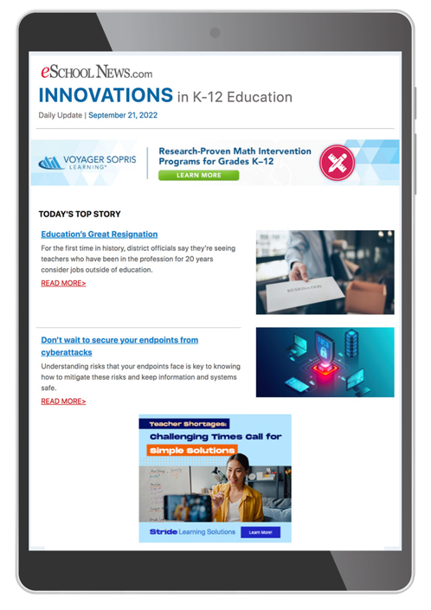
BRAND AWARENESS & ADVERTISING
Corporate eNewsletter Sponsorships
Corporate eNewsletter Sponsorships
Reach and engage decision-makers by sponsoring daily and weekly eMail newsletters.
Deliver your message directly to the inboxes of education administrators and decision-makers that have requested to receive daily and weekly news updates. As a sponsor, your marketing message will gain even more impact and authority by appearing alongside the high-value editorial content produced by our award-winning editorial team.

Slide 16
BRAND AWARENESS & ADVERTISING
Corporate eNewsletter Sponsorships
What you get:
Reserved banner placement based on positioning and chosen dates adjacent to our valuable editorial content.
Full campaign reporting to detail ROI based on opens, clicks, and click-throughs.

Slide 17

BRAND AWARENESS & ADVERTISING
Custom eNewsletter Sponsorships
eSchool News or eCampus News will create a custom newsletter on a
topic associated with your mission.
This client-centered newsletter will contain articles selected by our editors based on the topic selected by your company. In addition to topic-focused content, exclusive banner ads, provided by you, will be featured. The newsletter will be sent to at least 50,000 readers with select relevant titles.

Slide 18
BRAND AWARENESS & ADVERTISING
Custom eNewsletter Sponsorships
What you get:
Co-branded newsletter focusing on the topic of your choice.
Exclusive banner placement.
Distribution to 50,000 readers with relevant titles.
Full campaign reporting to detail ROI based on opens, clicks and click-throughs.

Slide 19

BRAND AWARENESS & ADVERTISING
AI in Education
eNewsletter Sponsorship
Amplify your brand and showcase your innovations.
Your Sponsorship the new AI in K-12 Education or AI in Higher Education weekly eNewsletters will put your brand front and center with 30,000 edtech decision-makers – making it an ideal opportunity to boost your brand visibility, expand your audience, and promote your company’s innovations.

Slide 20
BRAND AWARENESS & ADVERTISING
AI in Education eNewsletter Sponsorship
What you get:
Exclusive ad placement based on chosen date(s)* adjacent to our valuable editorial content.
Full campaign reporting to detail ROI based on opens, clicks and click-throughs.

Slide 21
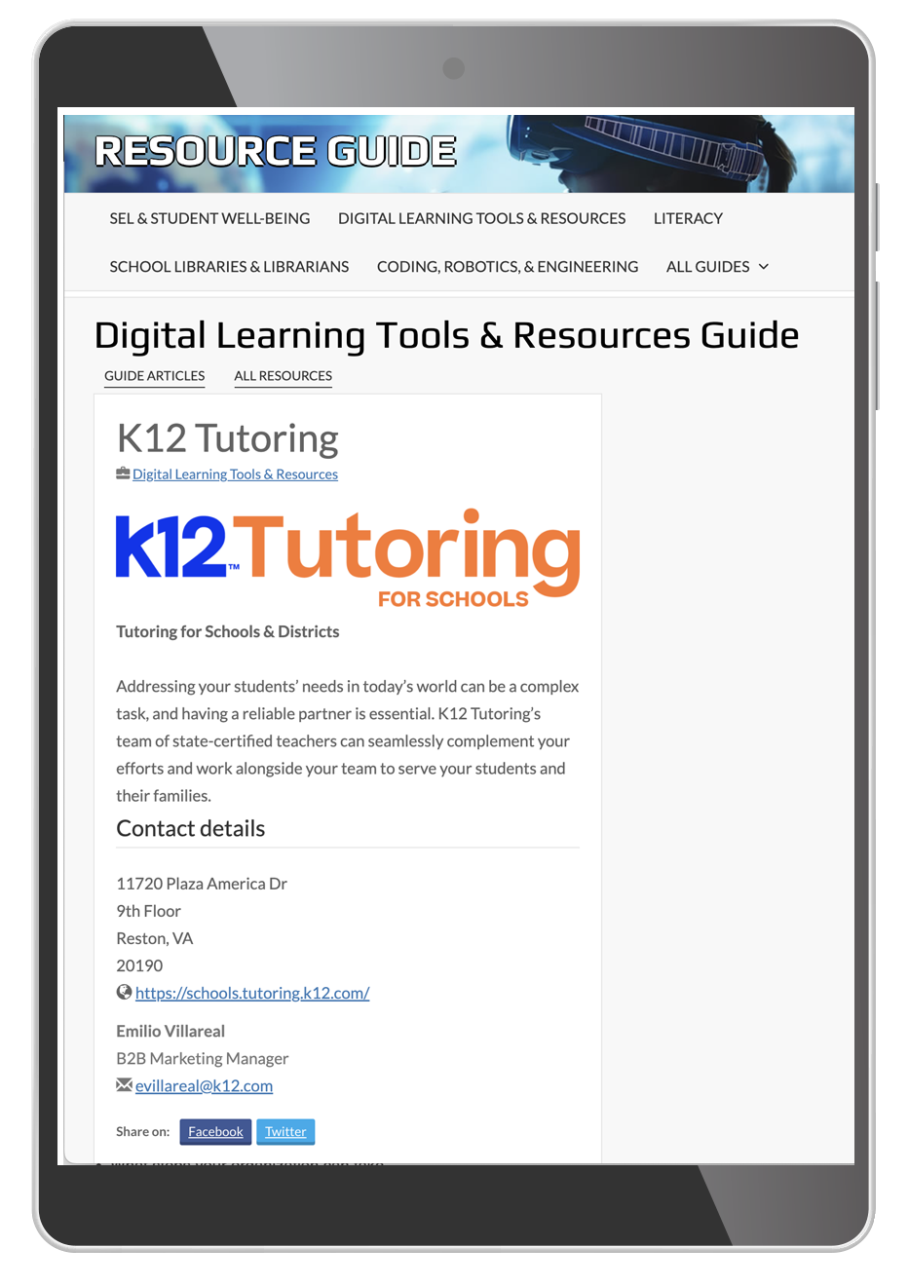
BRAND AWARENESS & ADVERTISING
eSchool News Monthly
Resource Guide
Get Brand Exposure for One Full Year.
eSchool News launched a new monthly Resource Guide that offers companies broad exposure to our K-12 readership through Featured Company Listings. Each monthly Resource Guide takes a deep dive into a different education topic, allowing you to place your Featured Company Listings in the month(s) most aligned with your products/services. Guides are promoted across channels monthly to over 150,000 K-12 professionals.

Slide 22
BRAND AWARENESS & ADVERTISING
eSchool News Monthly Resource Guide
What You Get:
Featured Company Listings include:
Company Name and Logo (linked)
Company Description – up to 50 words to showcase your services
Company Contact Information - Name, eMail, and Phone
Company Website

Slide 23
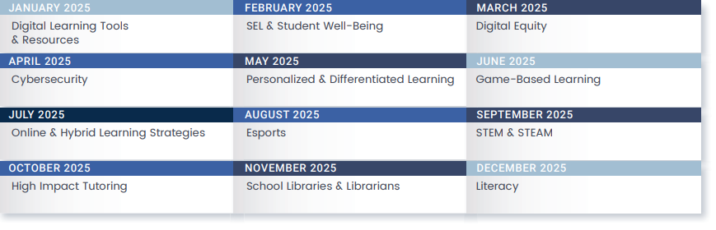
eSchool News
Monthly Guide Monthly Topics

Slide 24

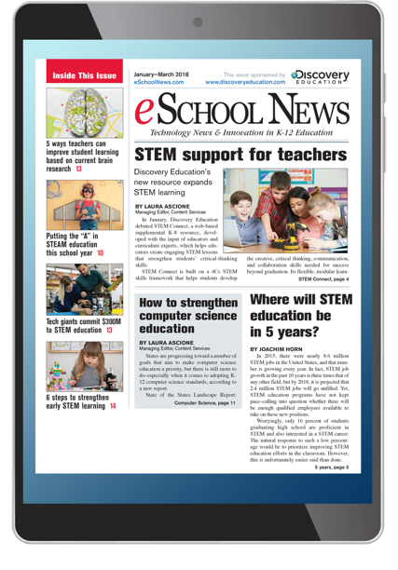
BRAND AWARENESS & ADVERTISING
Digital Publication Sponsorship
Engage education decision-makers by sponsoring an entire issue of eSchool News or eCampus News.
eSchool News and eCampus News now offer sponsorship opportunities in our digital publications for 2025. If you need a brand awareness program that gives you fantastic branding within an entire issue for impact and credibility, this is the best opportunity for your company.

Slide 25
BRAND AWARENESS & ADVERTISING
Digital Publication Sponsorship
What you get:
Sponsorship logo representation on every page of the digital issue.
Front cover logo stating that this publication is sponsored by your company.
Two inside full-page ads.
Each issue is emailed to 25,000 education decision-makers.
Digital distribution and placement on our website(s) for an entire year.

Slide 26
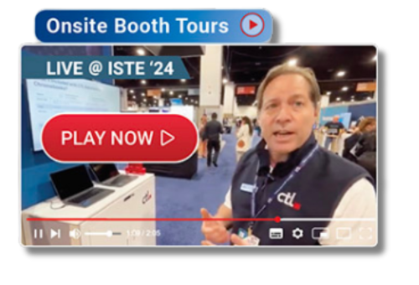
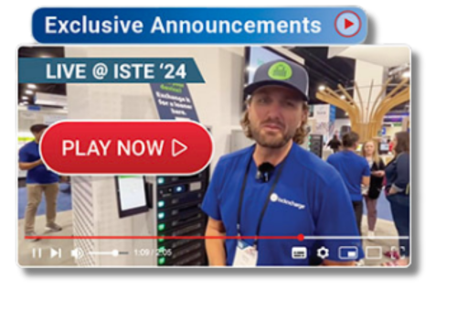
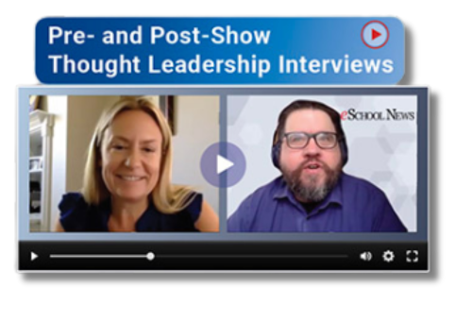
BRAND AWARENESS & ADVERTISING
LIVE@ Conference Video Sponsorships
We’ll showcase your innovations and expertise before, during and after leading edtech events.
FETC • TCEA • CoSN • ISTE • EDUCAUSE
Get LIVE editorial coverage at your next edtech event as a LIVE@Conference Video Sponsor. We’ll produce, post, and promote a custom video interview for your company that includes brand visibility,
booth location, and a link to your company website to ensure your event marketing investment reaches
its full potential.
Your video segment will feature company-driven messaging and receive preferred placement as native advertising on the LIVE@ event page.

Slide 27
BRAND AWARENESS & ADVERTISING
LIVE@ Conference Video Sponsorships
What you get:
Video interview featuring company-driven messaging is conducted by our editorial team before, during or after the event – up to 5 minutes.
Video segment receives preferred placement as native advertising on the LIVE@ event page, including sponsor’s name, brand visibility, and (1) embedded link to the company website.
Video post promoted across all eSchool Media social platforms, including company-provided handles and tags.
Choice of: Onsite booth tour, exclusive announcement, or thought leadership interviews

Slide 28
THOUGHT LEADERSHIP
We feature and promote your company’s expertise and leadership.

Slide 29
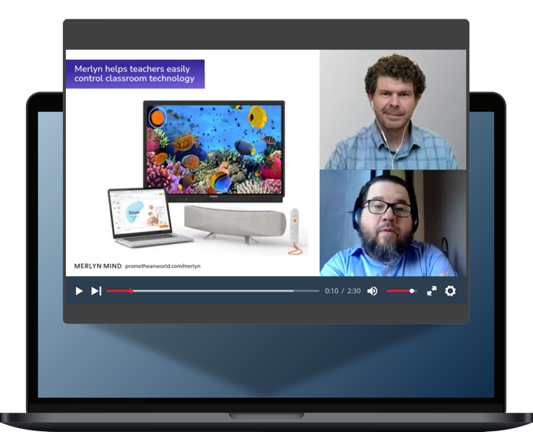
THOUGHT LEADERSHIP
Webinars
Share your unique story with decision-makers in an interactive environment, educating your prospects and generating qualified sales leads.
A webinar is a powerful online presentation tool that allows you to communicate your message and establish your company as a thought leader, while communicating directly to education technology decision-makers. With our webinars, the sponsor selects the topic and provides unique and informative content for the presentation, including an interactive Q&A. eSchool Media provides a talented editorial moderator to coordinate the event, assist the speakers and manage the Q&A.

Slide 30
THOUGHT LEADERSHIP
Webinars
What You Get:
A dedicated webinar project manager to coordinate the event, speakers, and practice session.
An experienced editorial moderator.
An integrated marketing campaign to drive registrations to the event.
200 guaranteed registration.
Website posting within our webinars section pre- and post-event.
3-month archive for an on-demand promotional use.
Full set up and logistical support.
Full post-event reporting, including questions asked, time attended, polling responses, registration, and attendee list.

Slide 31
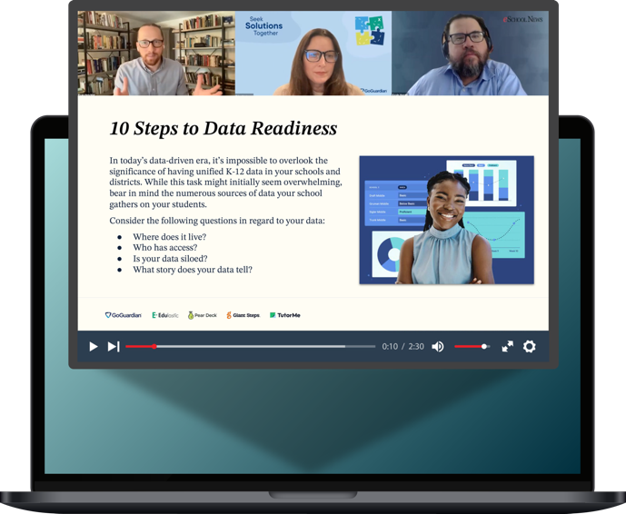
THOUGHT LEADERSHIP
Custom Webinars
Let us help develop your event.
Don’t have a webinar topic and speakers? No problem – eSchool Media can work with you to develop the webinar content and find the right speakers to showcase your company’s innovations and solutions. Our custom webinar allows you to communicate your message to edtech decision-makers while leaving the work to us.

Slide 32
THOUGHT LEADERSHIP
Custom Webinars
What You Get:
An experienced editorial moderator that will work with you to develop the content and secure speakers.
A dedicated webinar project manager to coordinate the event, speakers, and practice session.
An integrated marketing campaign to drive registrations to the event.
200 guaranteed registration.
Website posting within our webinars section pre- and post-event.
3-month archive for an on-demand promotional use.
Full set up and logistical support.
Full post-event reporting, including questions asked, time attended, polling responses, registration, and attendee list.

Slide 33

THOUGHT LEADERSHIP
Sponsored Podcasts
Three podcast options to boost brand awareness.
Sponsored Podcast – Add your company’s 30-second message to the open and close of our “Innovations in Education” podcasts for added branding and exposure. Podcasts are featured on our website and promoted as the “Top Story” through our daily newsletters and across all social channels.
Custom Podcast – For extra brand exposure, our moderator will conduct a 15-minute podcast interview with your company’s thought leader – audio only.
Custom Video Podcast – For even greater visibility, we’ll conduct a 15-minute video interview with your company spokesperson. The video becomes yours to post and share.

Slide 34
THOUGHT LEADERSHIP
Sponsored Podcasts
What You Get:
A dedicated project manager to coordinate your podcast sponsorship.
Website posting within our podcast section.
Podcast promotion in (2) newsletters.
(4) social promotions across all channels.
Broadcast rights to audio and video files.
Full set up and logistical support.
Podcasts posted on iTunes, Google, Stitcher, Amazon, and more.

Slide 35
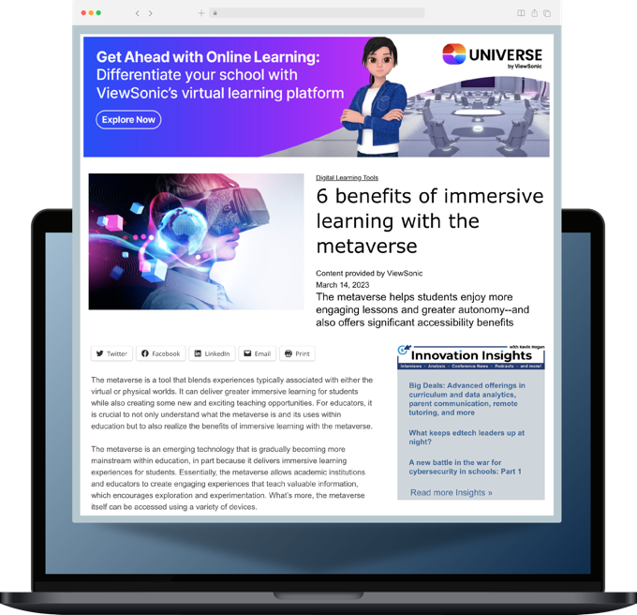
THOUGHT LEADERSHIP
Sponsored Content
Provide a well-written article to share with our audience and we’ll post it along with our daily editorial content.
Your content, labeled as Sponsored Content, seamlessly integrates with editorial content on our websites. You provide the article and we promote the content to our audience of decision-makers.

Slide 36
THOUGHT LEADERSHIP
Sponsored Content
What you get:
Premium promotion of your article in our eMail newsletters.
Full-text of article on eSchoolNews.com or eCampusNews.com.
Social sharing tools included on your article.
Content displayed as editorial, but byline will state "Content Provided by Sponsor" to maintain transparency.

Slide 37

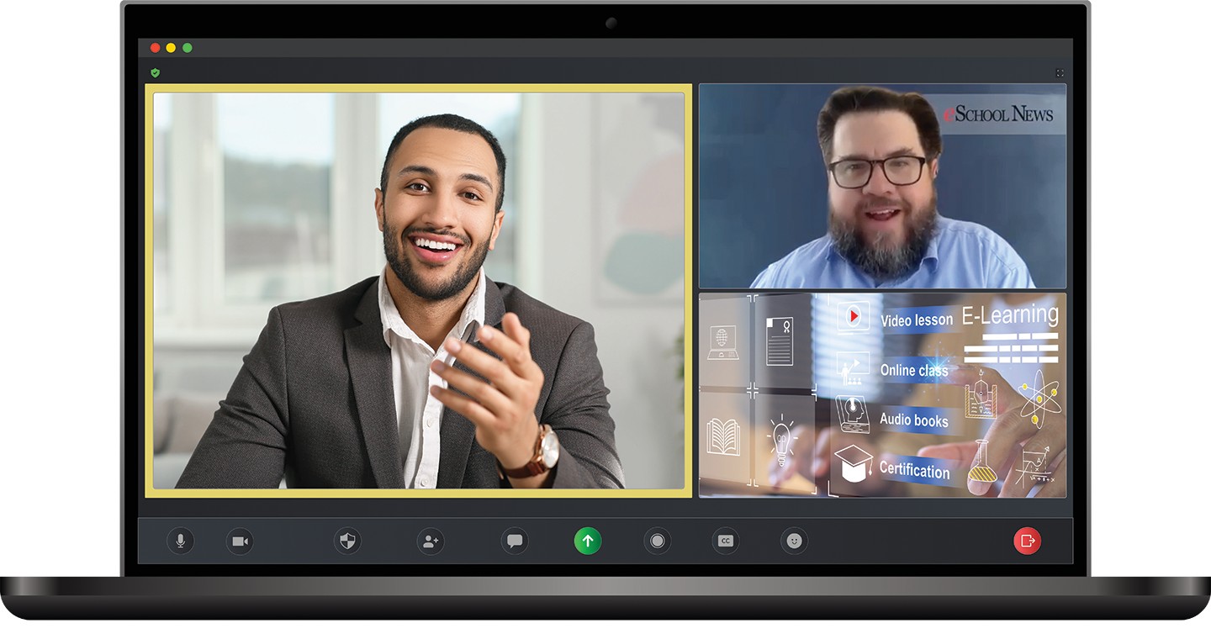
THOUGHT LEADERSHIP
Edtech Video Spotlight
Showcase your Innovations and Boost Brand Awareness!
An Edtech Video Spotlight interview conducted by our editorial team provides a powerful platform to communicate your company’s message directly to education technology decision-makers. We’ll interview your company spokesperson on the topic of your choice and produce a 3-5-minute professional video interview that will seamlessly integrate into the editorial content on the eSchool News or eCampus News websites.
Your Edtech Spotlight Video will be promoted across all marketing channels to ensure your company-driven message receives broad exposure to our education audience.

Slide 38
THOUGHT LEADERSHIP
Edtech Video Spotlight
What you get:
A dedicated project manager to coordinate your video interview
Website posting within the Innovation Insights section
Video promotion in (2) newsletters
(4) social promotions across all channels
Broadcast rights to audio and video files
Full set up and logistical support

Slide 39
CUSTOM CONTENT CREATION
We develop compelling, impactful content to showcase your solutions.

Slide 40

CONTENT CREATION SERVICES
White Papers
Generate qualified sales leads with a unique and compelling white paper that showcases your company’s innovations and solutions.
Let the eSchool Media expert editorial team create a unique and strategic content marketing piece. This custom white paper will be co-branded featuring your company profile and logo. Your custom white paper will then be hosted on the eSchool News or eCampus News website and promoted via a strategic marketing campaign to generate qualified leads.

Slide 41
CONTENT CREATION SERVICES
White Papers
What You Get:
Dedicated eSchool Media project manager.
Up to 2,000 words of professional editorial content.
Complete design and productions services (up to 2 rounds of editing).
A final PDF of your white paper for your use.
Placement of your white paper on our website(s) for instant download.
An integrated marketing campaign to drive decision-makers to view your content.
Weekly lead reporting, including all relevant data.

Slide 42
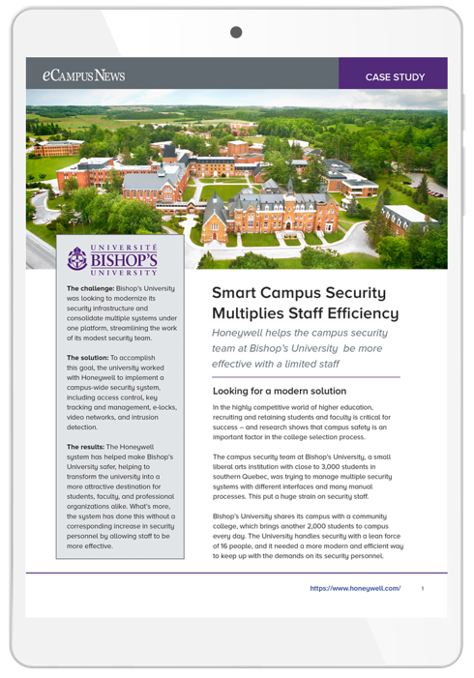
CONTENT CREATION SERVICES
Case Studies
Generate qualified sales leads with a customer case study that spotlights your solutions.
Our editorial team will collaborate with you and your edtech customers to develop a brief strategic content marketing piece to help boost awareness and spread your product messaging to technology decision-makers. This success story will highlight your product and showcase the successful impact in education.

Slide 43
CONTENT CREATION SERVICES
Case Studies
What You Get:
Dedicated eSchool Media project manager.
Up to 1,000 words of professional editorial content.
Complete design and productions services (up to 2 rounds of editing).
A final PDF of your case study for your use.
Placement of your case study on our website(s) for instant download.
An integrated marketing campaign to drive decision-makers to view your content.
Weekly lead reporting, including all relevant data.

Slide 44

CONTENT CREATION SERVICES
Ebook
Generate qualified leads as our editorial team puts together a unique and compelling message surrounding your technology innovations and solutions.
Let the eSchool Media expert editorial team create a unique and strategic content marketing piece. This custom Ebook will be co-branded featuring your company profile and logo. Your custom Ebook will then be hosted on the eSchool News or eCampus News website and promoted via a strategic marketing campaign to generate qualified leads.

Slide 45
CONTENT CREATION SERVICES
Ebook
What You Get:
Dedicated eSchool Media project manager.
Up to 2,000 words of professional editorial content.
Complete design and productions services (up to 2 rounds of editing).
A final PDF of your Ebook for your use.
Placement of your asset on our website(s) for instant download.
An integrated marketing campaign to drive decision-makers to view your content.
Weekly lead reporting, including all relevant data.

Slide 46

CONTENT CREATION SERVICES
Top 10 Report
Use our editorial expertise to develop a co-branded report focusing on the key selling benefits of your product or service.
Connect and engage top edtech decision-makers with solution-oriented marketing. Choose a solution and let the eSchool Media editorial team create your Top 10 Report to provide a series of tips or steps that help your targets solve a problem or guide them in the decision-making process.

Slide 47
CONTENT CREATION SERVICES
Top 10 report
What You Get:
Dedicated eSchool Media project manager.
Up to 1,000 words of professional editorial content.
Complete design and productions services (up to 2 rounds of editing).
Placement of your asset on our website(s) for instant download.
A final PDF of your Top 10 Report for your use.
An integrated marketing campaign to drive decision-makers to view your content.
Weekly lead reporting, including all relevant data.

Slide 48

CONTENT CREATION SERVICES
Special Report
Pair your marketing message with our original editorial to create a report showcasing your mission.
Our award-winning editorial staff prepares Special Reports to assist our readers in making better purchasing decisions throughout the year. We pair your organization’s important marketing message with original editorial, so your sponsored Special Report showcases your mission to a receptive audience of edtech decision-makers.

Slide 49
CONTENT CREATION SERVICES
Special Report
What You Get:
Dedicated eSchool Media project manager.
Up to 2,500 words of professional editorial content.
Complete design and productions services.
Placement of your asset on our website(s) for instant download.
A final PDF of your Special Report for your use.
Educator Resource Center to showcase your Special Report along with additional related information from your company.
An integrated marketing campaign to drive decision-makers to view your content.
Weekly lead reporting, including all relevant data.

Slide 50

CONTENT CREATION SERVICES
Edtech Point of View
Showcase one of your company executives as an industry thought leader.
The Edtech Point of View offers a platform in which to showcase one of your company executives as a thought leader in the edtech market. A custom report will be written in collaboration with the eSchool Media editorial staff to set the tone and communicate the challenges facing schools and campuses today.

Slide 51
CONTENT CREATION SERVICES
Edtech Point of View
What You Get:
Dedicated eSchool Media project manager.
Up to 2,000 words of professional editorial content.
Complete design and productions services (up to 2 rounds of editing).
Placement of your POV on our website(s) for instant download.
A final PDF of your POV for your use.
An integrated marketing campaign to drive decision-makers to view your content.
Weekly lead-reporting, including all relevant data.

Slide 52

CONTENT CREATION SERVICES
Voices from the Field
Highlight your thought leadership and solutions in a custom piece featuring expert insights from education leaders—including your company’s expert.
This custom report features authentic responses from two IT leaders and/or administrative leaders in education. The eSchool Media editorial team, in collaboration with your team, identifies five questions for in-depth responses. Once the responses are available, your team will review and offer their professional insights to the same five questions. The final report would be available on eSchool News or eCampus News for download. Your company retains the intellectual property of the report.

Slide 53
CONTENT CREATION SERVICES
Voices from the Field
What You Get:
Dedicated eSchool Media project manager.
Up to 2,000 words of professional editorial content.
Complete design and productions services (up to 2 rounds of editing).
Placement of your VFF on our website(s) for instant download.
A final PDF of your VFF for your use.
An integrated marketing campaign to drive decision-makers to view your content.
Weekly lead-reporting, including all relevant data.

Slide 54
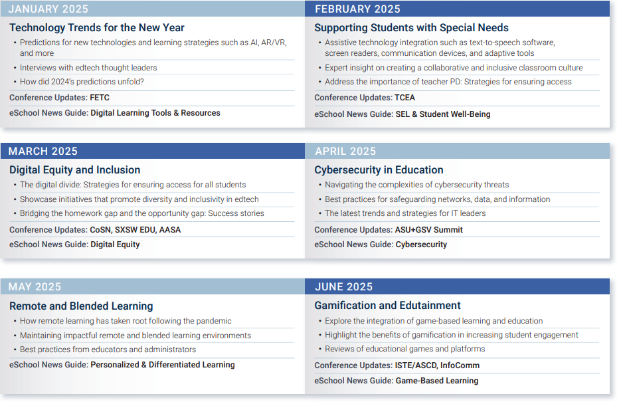
eSchool News
2025
eSchool News
Editorial Calendar
January-June

Slide 55
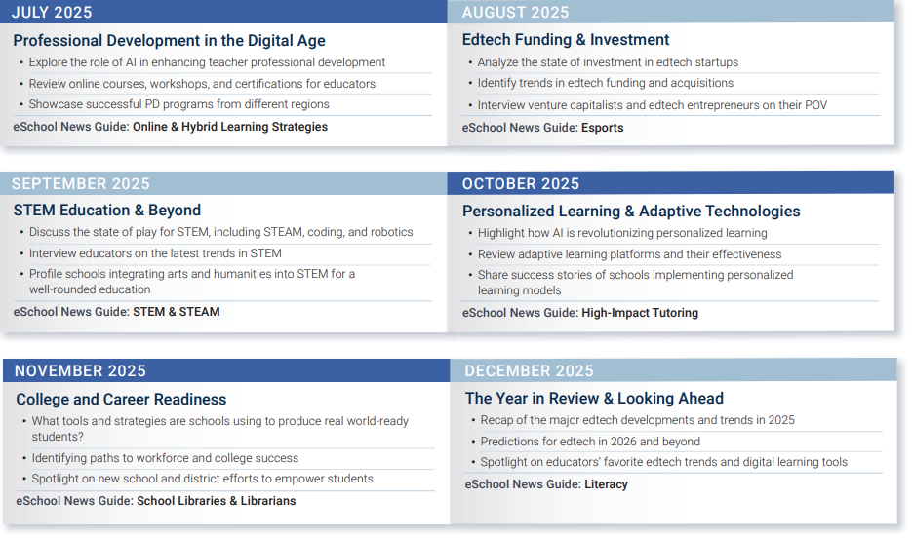
eSchool News
2025
eSchool News
Editorial Calendar
July-December

Slide 56
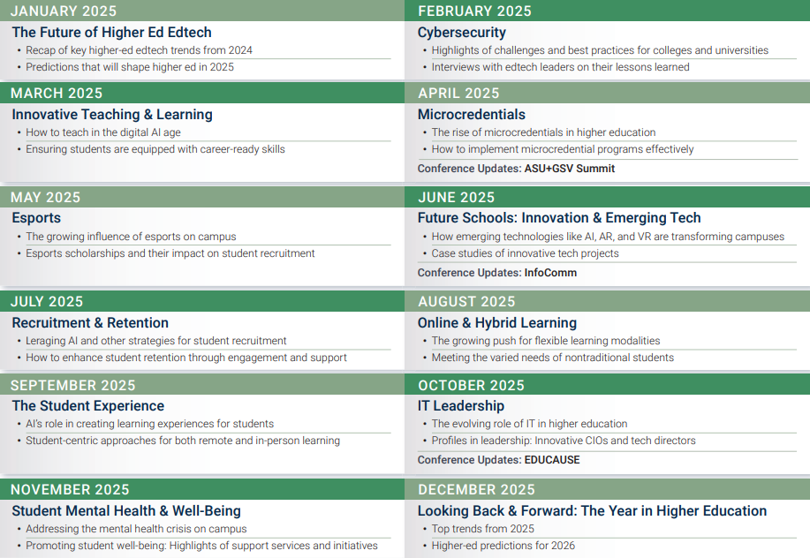
eCampus News
2025
eCampus News
Editorial Calendar

Slide 57
K-12 Titles for Content Syndication and Chaperoned Emails
CIOs/CTOs / Tech Directors
Superintendents + Assistant Superintendents
District Level Administrators (Superintendents, District Admin, School Board Presidents)
Curriculum Directors and Coordinators
Principals + Assistant Principals
School Administrators (Dean, Business Director, CEO, Head of School, etc.)
IT Managers, Tech Coordinators
Instructional Tech Coordinators
Library Directors, Librarians, Media Specialists
School Board Presidents / Members
Department Chairs
STEM Professionals
Directors of Special Needs
Teachers

Slide 58
Higher Ed Titles for Content Syndication and Chaperoned Emails
Faculty Department Chairs
Academic Affairs Administration
Deans
Professors
Executive Level Administrators (Presidents, Vice Presidents, Chancellors & Provosts)
Admissions
Business Administration
Student Affairs Administration
CIOs/CTOs/Tech Titles
Security Chiefs
Library & Media
STEM-Related Titles
Curriculum and Distance Learning
Marketing PR Donations
Finance and HR

Slide 59
Proposed Campaign Summary
Product | Pricing
Total

Slide 60
THANK YOU!
Jane Radenhausen
J Daly Associates
407.898.2876 jane@jdalyassociates.com

